Slide 1
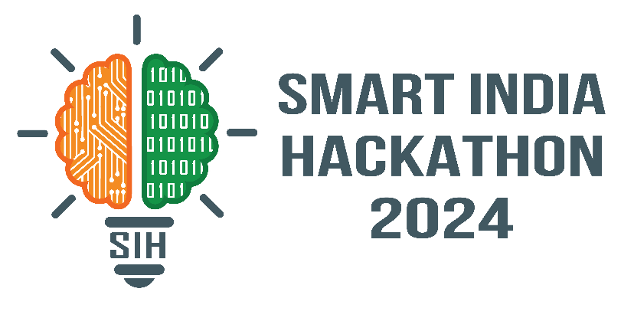
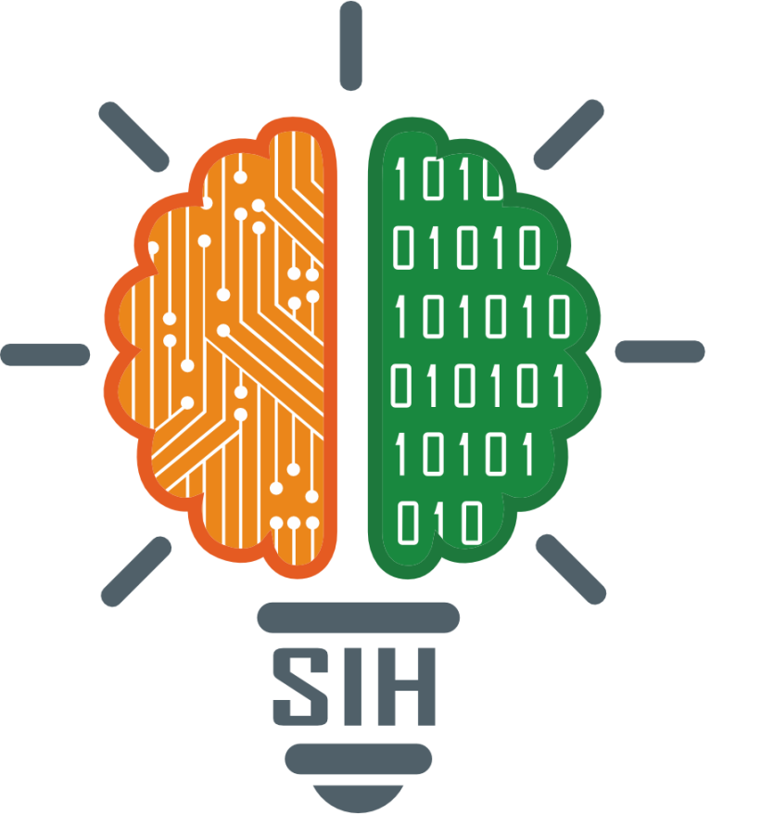
SMART INDIA HACKATHON 2024
Problem Statement ID - 1733
Problem Statement Title - SAR Image Colorization for Comprehensive Insight using Deep Learning Model
Theme - Space Technology
PS Category- Software
Team ID -
Team Name - VOID

Slide 2
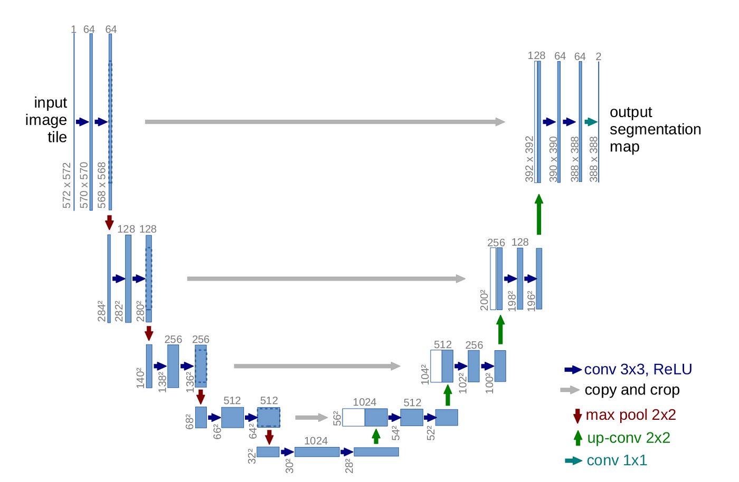
SAR Image colorization with U-Net Architecture
VOID
Problem Statement: Develop a deep learning model to accurately colorize grayscale Synthetic Aperture Radar (SAR) images, enhancing feature interpretation and analysis for remote sensing applications.
Solution
Used U-Net architecture for accurate SAR image colorization.
Captured fine structural details for accurate color reconstruction, enhancing SAR data interpretability in remote sensing.
By using a Hybrid model of GAN and U-Net architecture, we can achieve an accuracy of 90-95%.
Advantages
Enhanced Visualisation: Clearer, more detailed images for improved feature recognition.
Improved Data Analysis: Easier interpretation of large datasets for faster decision-making.
Increased Classification Accuracy: Better terrain differentiation for precise classification.
Adaptability: Easily applicable to other image translation tasks.
U-Net Architecture

Slide 3

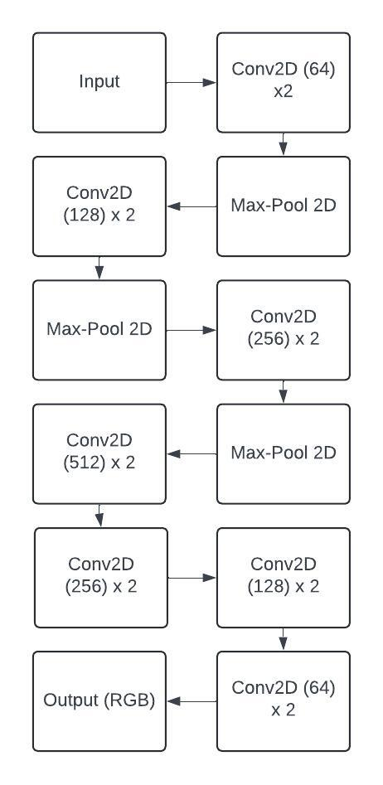




TECHNICAL APPROACH
VOID
TechStack Used
Preprocessing: EuroSAT colour images are converted to grayscale using OpenCV for model input.
Data Loading: Images are resized to (64x64) and normalized.
Model Architecture: U-Net is used for image colorization, with an encoder to extract features and a decoder to reconstruct RGB images.
Training: The model is trained with MSE loss and Adam optimiser on the training dataset.
Evaluation: Performance is validated by comparing grayscale inputs with predicted colorized outputs.
E
N
C
O
D
E
R
D
E
C
O
D
E
R
MODEL DESIGN

Slide 4
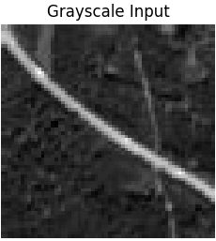
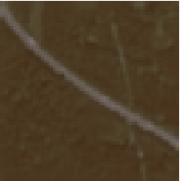
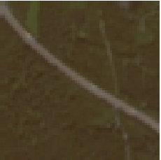
FEASIBILITY AND VIABILITY
VOID
Technical Feasibility:
U-Net’s proven efficiency in image segmentation and colorization tasks makes it highly suitable for SAR image processing.
Utilises the EuroSAT dataset for diverse and comprehensive training and evaluation.
Implementable with TensorFlow and OpenCV, ensuring seamless integration with cutting-edge ML and image processing libraries.
Viability:
Enhances interpretability of SAR data for remote sensing applications.
Scalable solution adaptable to large datasets.
Potential for integration into real-world systems for environmental monitoring, disaster management, and geological studies.
Challenges:
High computational requirements for training.
Ensuring accurate colorization in diverse terrains and conditions.
Source Image
Predicted Image
True Image

Slide 5
IMPACT AND BENEFITS
VOID
Impact:
Geological Studies: Enhanced mapping and analysis of geological features.
Environmental Monitoring: Improved detection of environmental changes and resource management.
Remote Sensing Analysis: Clearer SAR images for more efficient analysis.
Benefits:
Social: Better disaster management and urban planning decisions.
Economic: Reduce cost of analysis and time, boosting efficiency.
Environmental: Supports sustainable resource management with precise data.
Product Status :
Our U-Net model for SAR image colorization has reached 87-89% accuracy.
We can improve accuracy upto 90-95% by optimising hyperparameters, using data augmentation, fine-tuning the architecture, and applying transfer learning.

Slide 6
RESEARCH AND REFERENCES
VOID
Key Research:
U-Net for Image Segmentation: Ronneberger, O., Fischer, P., & Brox, T. (2015). U-Net: Convolutional Networks for Biomedical Image Segmentation.
SAR Image Processing: Zhang, L., & Xu, Y. (2020). Synthetic Aperture Radar (SAR) Image Processing and Analysis.
F. Muscat and T. Gatt, "Black and White Image Colorization Using Deep Learning Techniques," 2023 International Symposium on Image and Signal Processing and Analysis.
J. Hwang, "Image Colorization with Deep Convolutional Neural Networks", 2016
Datasets:
EuroSAT Dataset
EuroSAT Gray Scale: Custom preprocessing script for converting color images to grayscale.
Tools & Libraries:
TensorFlow
OpenCV

